Slide 1
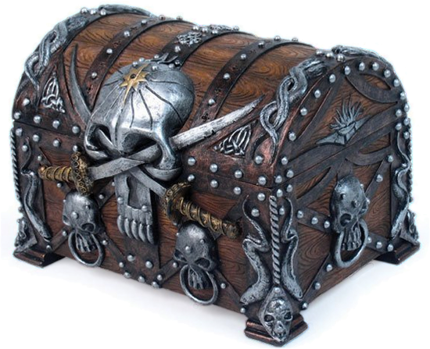
OneEyed And the adventure of Mataconejos treasure

Slide 2

The Team A Narwhal Team

Slide 3

Previous Scope
3 LEVELS
3 SHIPS WITH DIFFERENT MECHANICS
3 DIFFERENT SCENES WITH DIFFERENT DECORATION

Slide 4
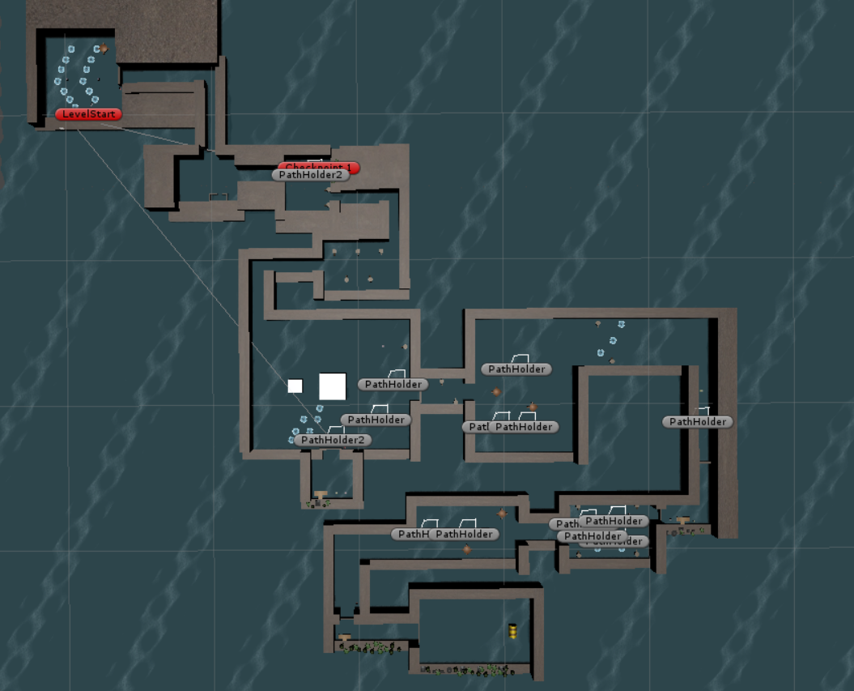
ONE LEVEL

Slide 5
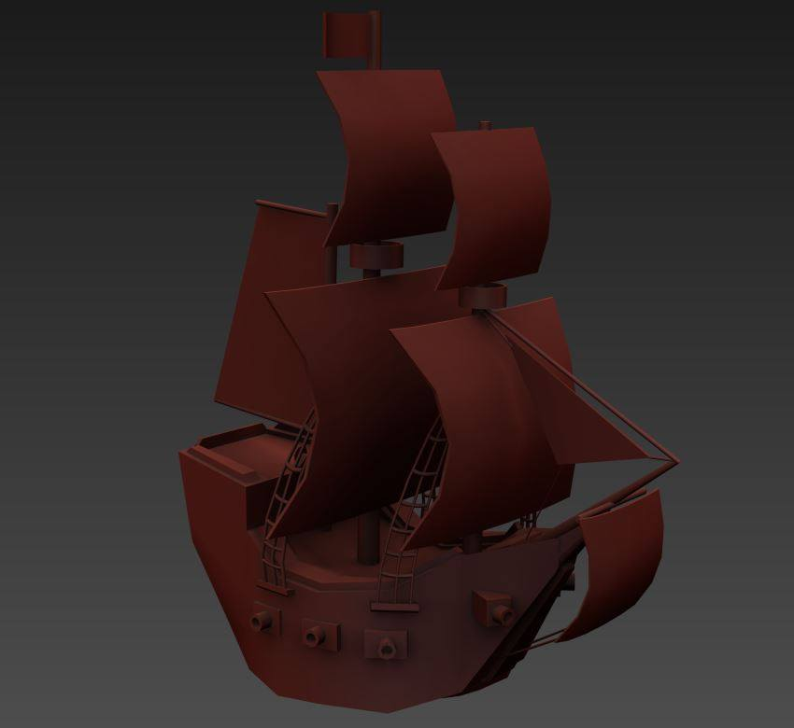
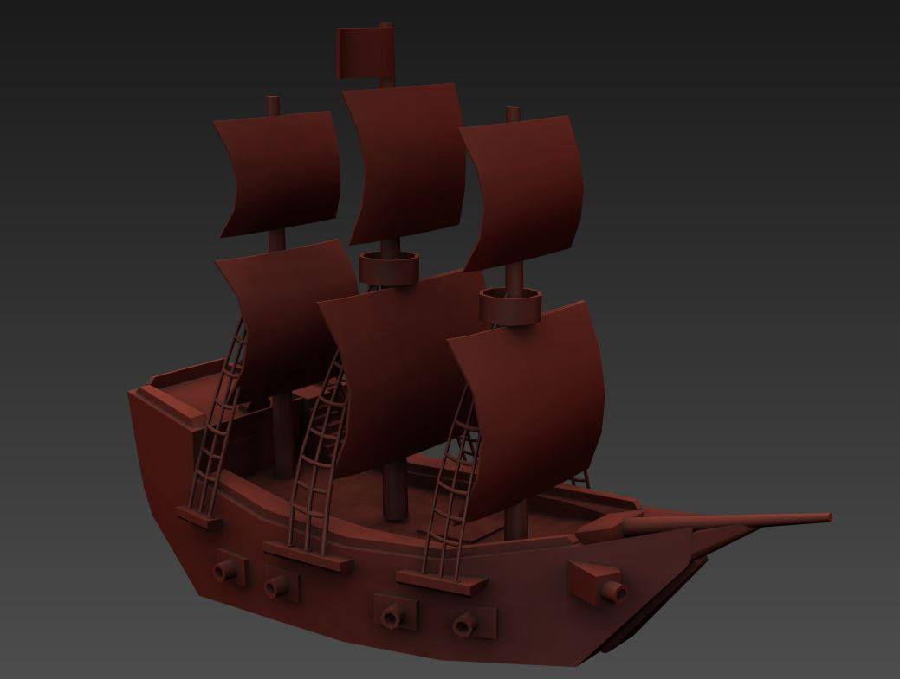

GamePlay and Theme Mix
NEW SHIP

Slide 6
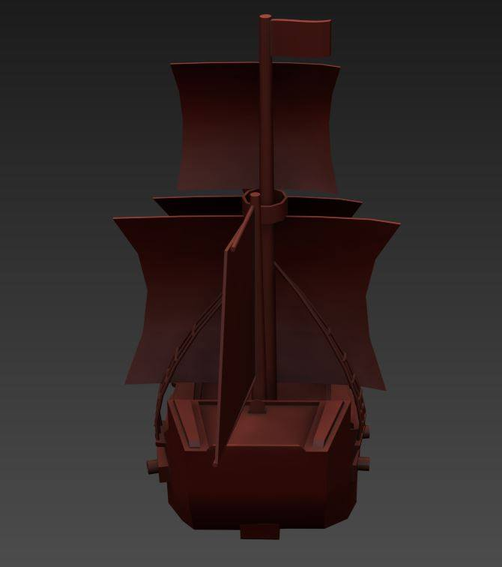
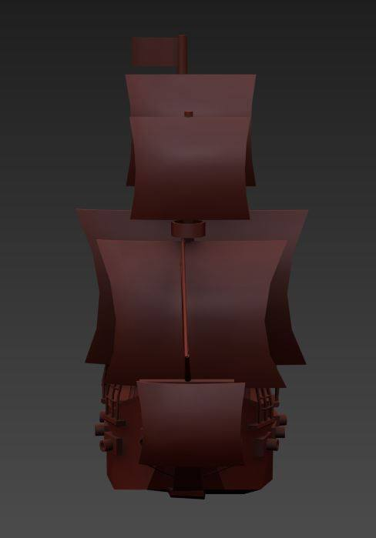
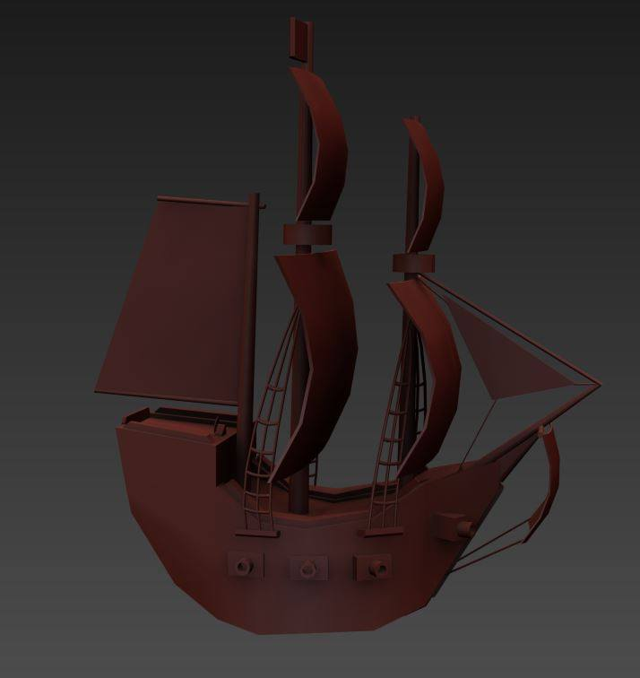

Slide 8
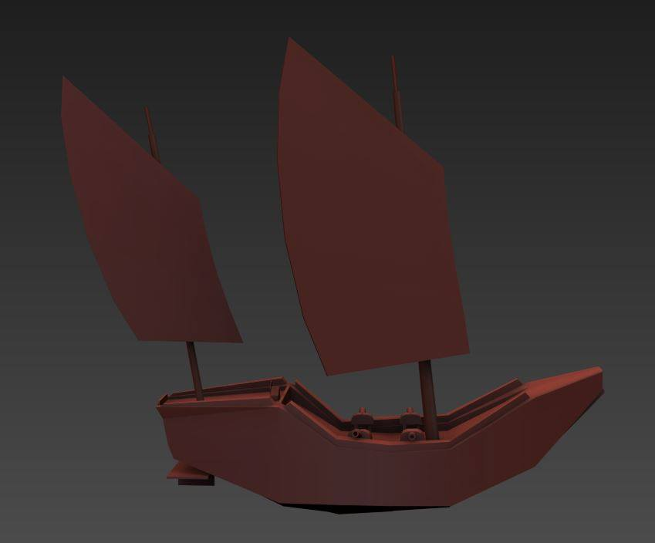
CHINESE
Enemies
· Those ships attack the player
· They defend comercial Harbourts

Slide 9

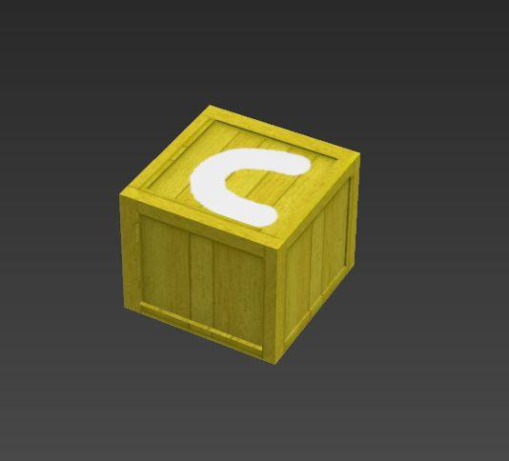
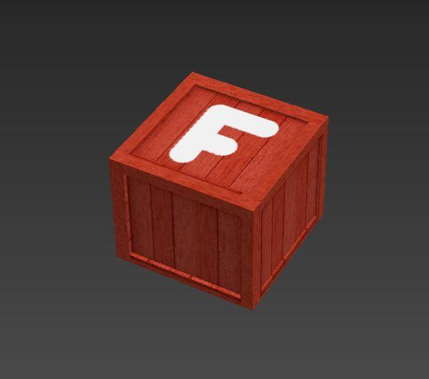
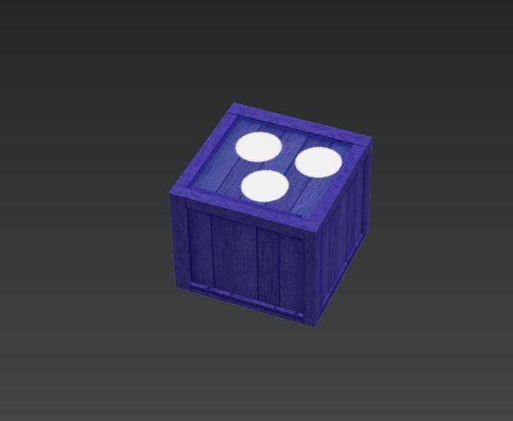
Mechanics
Destroy enemies
Pick up power ups to beat them
Shoot dianas to open doors
Look it for the Harbours (CHECKPOINTS)

Slide 10
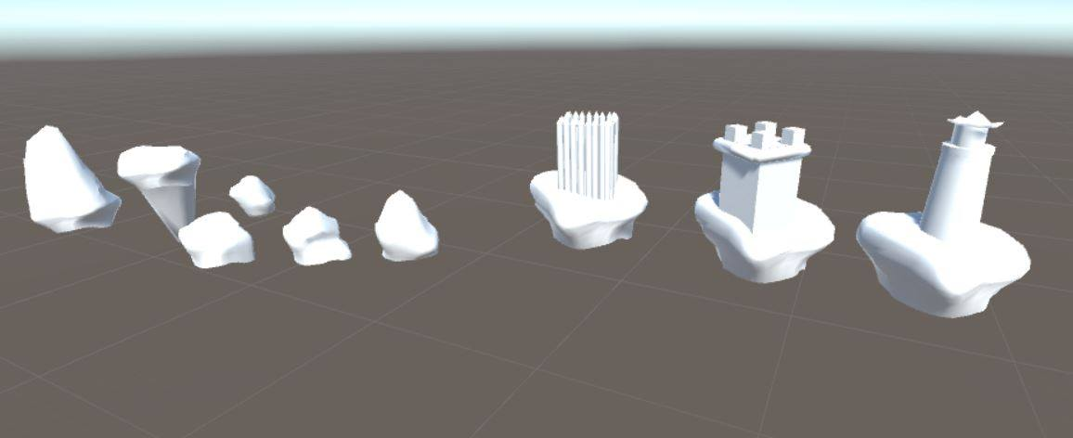
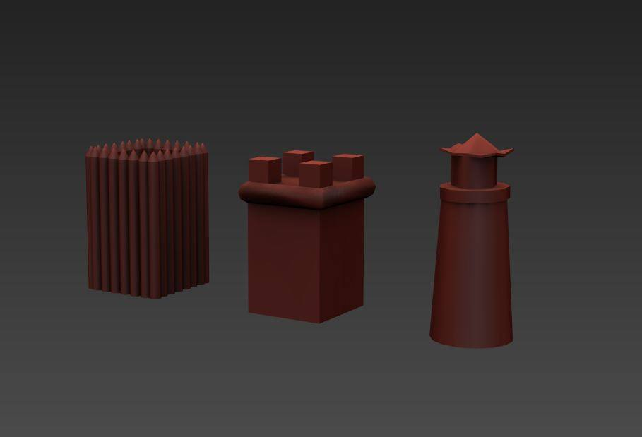
Enemies and NPC
Enemy ships
Static Turrets
The Fire Spittoon

